Slide 1

Tendo OOP model for New Users
Presented by:
Data Science
CEO Update: 22th April 2025

Slide 2
OOP model 1st Draft: Target definition
Final Payment - Leave date + | TPSD | TPSD | TPSD | TPSD |  | Leave date
Final Payment + | TPSD | TPSD | TPSD | TPSD |  |  | Final payment |  |  | Last Paid Due Date
Final Payment + | TPSD | TPSD | TPSD | TPSD |  | Last Paid Due Date | Final payment
Check self payments
Check self payments
Check self payments
Check self payments
Observation window = 5 month
Performance window = 2 month (with exception in scenario 2)
We consider only employees with known resignation date, permanent freeze date or final payment.
We consider only cases with OSBal > 0 after last TPSD and Final Payment

Slide 3
OOP model: Concepts of Onboarding Cohorts and Observation Window
 | 2023 |  |  | 2024
Onboarding dates | Jan | ... | Dec | Jan | Feb | Mar | Apr | May | Jun | … Dec
Train data [6 210]: randomly selected onboarding (=calculation) date
Test data [1 793]: randomly selected onboarding (=calculation) date
We take only those Employees who are Active Employees with that Employer AND Active Tendo Customers as of the Calculation Start Date
We take only Employees with known resignation date, permanent freeze date or final payment date
We calculate the Features for those Employees and their Employers as of their Onboarding Date

Slide 4
OOP model: Features
# | Feature Name | Description
1 | Employee's Phone Telco Name = 'Globe' | [Binary] Identified based on the phone number prefix. Value is 1 if the telco is 'Globe'; otherwise, 0.
2 | Employee's Phone Telco Name = 'Smart' | [Binary] Identified based on the phone number prefix. Value is 1 if the telco is 'Smart'; otherwise, 0.
3 | Employee's Age | [Numerical] Age in years as of the calculation date, based on birthdate. Missing values and ages above 70 are replaced with the median (31 years). The result is then log-transformed and scaled to the [0, 1] interval.
4 | Employer Size (JobStreet) = 'Not specified' | [Binary] Retrieved from JobStreet for the top 75 Tendo employers. Value is 1 if the company is listed but its size is not specified; otherwise, 0.
5 | Employer Size (JobStreet) = 'More than 10,000 employees' | [Binary] Retrieved from JobStreet for the top 75 Tendo employers. Value is 1 if the listed company size is 'More than 10,000 employees'; otherwise, 0.
6 | Employer Size (JobStreet) = '51–100 employees' | [Binary] Retrieved from JobStreet for the top 75 Tendo employers. Value is 1 if the listed company size is '51–100 employees'; otherwise, 0.
7 | Employer Size (JobStreet) = '101–1,000 employees' | [Binary] Retrieved from JobStreet for the top 75 Tendo employers. Value is 1 if the listed company size is '101–1,000 employees'; otherwise, 0.
8 | Employer Size (JobStreet) = 'Missed' | [Binary] Retrieved from JobStreet for the top 75 Tendo employers. Value is 1 if the employer is not listed on JobStreet or not among the top 75; otherwise, 0.
9 | Lead role | [Binary] Indicates whether the raw job title contains keywords related to a lead role.
10 | IT support role | [Binary] Indicates whether the raw job title contains keywords related to an it support role.
11 | Associate role | [Binary] Indicates whether the raw job title contains keywords related to an associate role.

Slide 5
OOP model: Features
# | Feature Name | Description
12 | Number of onboarded employees = '50-250' | [Binary] Based on the number of active employees as of the calculation date. An employee is considered active if they were onboarded before the calculation date and had not resigned. Value is 1 if the number of active employees falls within the (50, 250] range; otherwise, 0.
13 | Number of onboarded employees = '250-1000' | [Binary] Based on the number of active employees as of the calculation date. An employee is considered active if they were onboarded before the calculation date and had not resigned. Value is 1 if the number of active employees falls within the (250, 1,000] range; otherwise, 0.
14 | Employer Recommendation Level (JobStreet) | [Numerical] Retrieved from JobStreet for the top 75 Tendo employers. If not available or not specified, the value is set to 0. The feature is standardized to the [0, 1] interval.
15 | Employee region = 'western visayas' | [Binary] Based on the provided province. Value is 1 if the identified region is 'Western Visayas'; otherwise, 0.
16 | Employee region = 'others' | [Binary] Based on the provided province. Value is 1 if the region is not one of the following: 'NCR', 'Calabarzon', 'Central Luzon', 'Western Visayas', or 'Central Visayas'; otherwise, 0.
17 | Employee region = 'ncr' | [Binary] Based on the provided province. Value is 1 if the identified region is 'NCR'; otherwise, 0.
18 | Employee region = 'central_luzon' | [Binary] Based on the provided province. Value is 1 if the identified region is 'Central Luzon'; otherwise, 0.
19 | Employee region = 'central_visayas' | [Binary] Based on the provided province. Value is 1 if the identified region is 'Central Visayas'; otherwise, 0.

Slide 6
OOP model: Performance
Logistic regression
Train/Test | Time period | Gini
Train | Jan 2023 – Mar 2024 | 0.2334
Test | Apr 2024 – Dec 2024 | 0.2783
Test | Apr 2024 | 0.1876
Test | May 2024 | 0.3087
Test | June 2024 – Dec 2024 | 0.3300

Slide 7
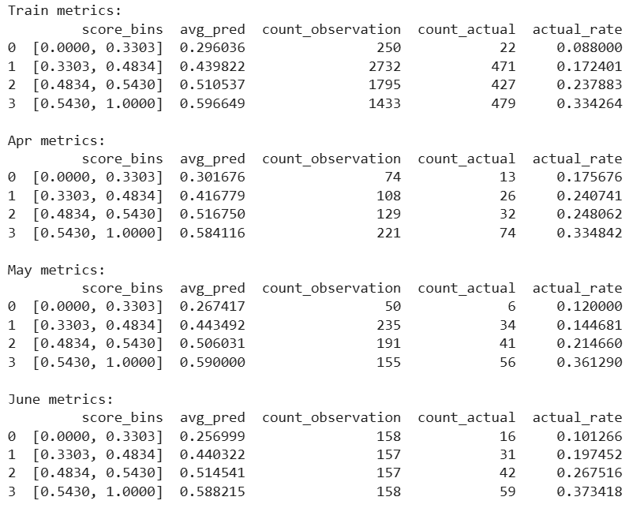
OOP model: 4 bins

Slide 8
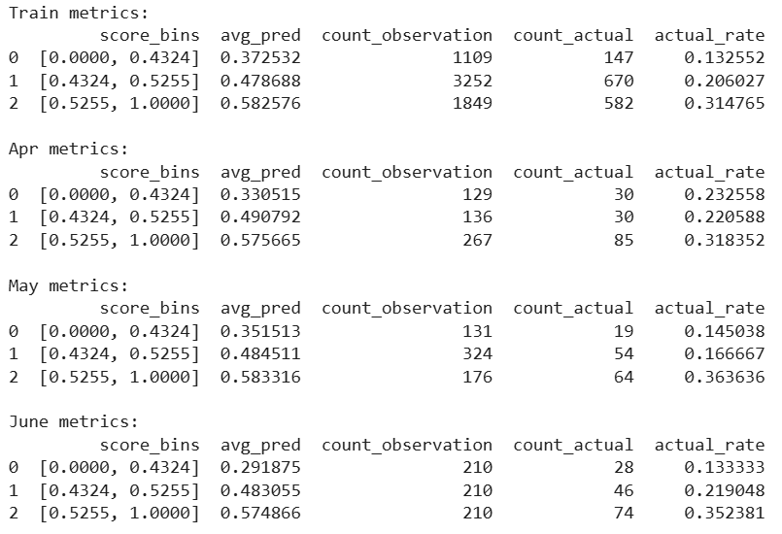
OOP model: 3 bins

